Slide 1







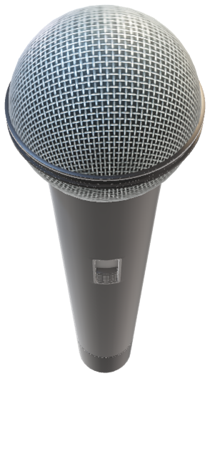

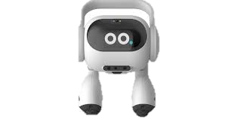

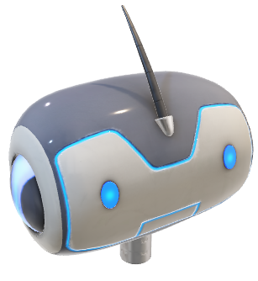
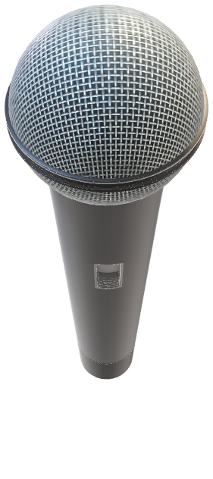
GEMY

Slide 2

GEMY V1.0
Team :
Taha fawzy anwar ,omar eldosoky ,mazen elsayed ,omar
Powered by

